Slide 1
Lecture 02 – Part A
Problem Solving by Searching
Search Methods :
Uninformed (Blind) search

Slide 2
Search Methods
Once we have defined the problem space (state representation, the initial state, the goal state and operators) is all done?
Let’s consider the River Problem:
A farmer wishes to carry a wolf, a duck and corn across a river, from the south to the north shore. The farmer is the proud owner of a small rowing boat called Bounty which he feels is easily up to the job. Unfortunately the boat is only large enough to carry at most the farmer and one other item. Worse again, if left unattended the wolf will eat the duck and the duck will eat the corn.
How can the farmer safely transport the wolf, the duck and the corn to the opposite shore?
River
boat
Farmer, Wolf,
Duck and Corn

Slide 3
Search Methods
The River Problem:
F=Farmer W=Wolf D=Duck C=Corn /=River
How can the farmer safely transport the wolf, the duck and the corn to the opposite shore?
-/FWCD
FWCD/-

Slide 4
Search Methods
Problem formulation:
  State representation: location of farmer and items in both sides of river
  [items in South shore / items in North shore] : (FWDC/-, FD/WC, C/FWD …)
  Initial State: farmer, wolf, duck and corn in the south shore FWDC/-
  Goal State: farmer, duck and corn in the north shore
  -/FWDC
  Operators: the farmer takes in the boat at most one item from one side to the other side
  (F-Takes-W, F-Takes-D, F-Takes-C, F-Takes-Self [himself only])
  Path cost: the number of crossings

Slide 5
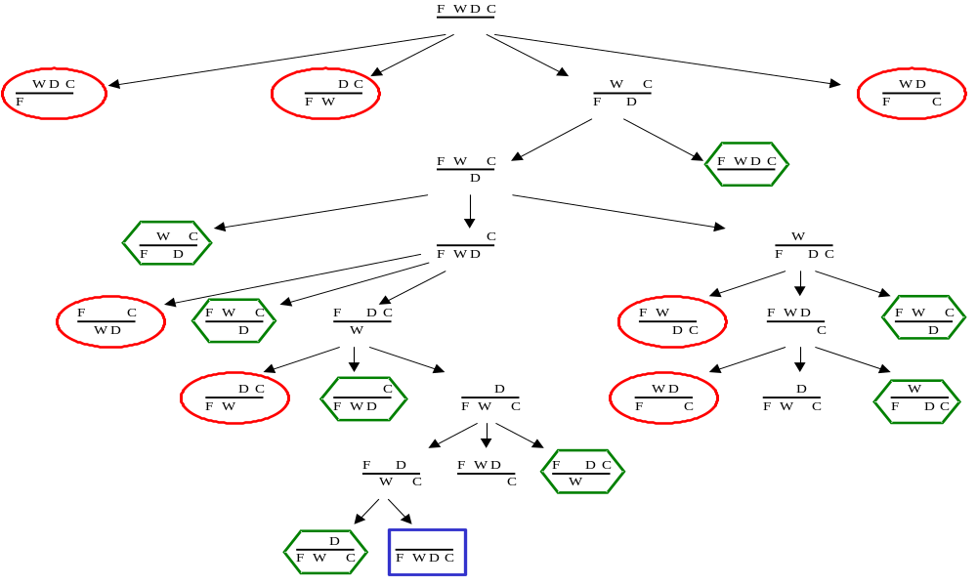
Search Methods
State space:
A problem is solved by moving from the initial state to the goal state by applying valid operators in sequence. Thus the state space is the set of states reachable from a particular initial state.
Initial state
Dead ends
Illegal states
repeated state
intermediate state
Goal state

Slide 6
Search Methods
Searching for a solution:
We start with the initial state and keep using the operators to expand the parent nodes till we find a goal state.
…but the search space might be large…
…really large…
So we need some systematic way to search.

Slide 7
Search Methods
Problem solution:
A problem solution is simply the set of operators (actions) needed to reach the goal state from the initial state:
F-Takes-D, F-Takes-Self, F-Takes-W,
F-Takes-D, F-Takes-C, F-Takes-Self,
F-Takes-D.

Slide 8
Search Methods
Problem solution: (path Cost = 7)
While there are other possibilities here is one 7 step solution to the river problem
F
D
D
F
W
D
F-Takes-D
F-Takes-S
F-Takes-W
F
W
D
C
W
C
F
W
C
C
Initial State
WC/FD
FWC/D
C/FWD
F-Takes-D
F
W
G
C
W
C
F
W
C
W
F-Takes-D
F-Takes-S
F-Takes-C
F
D
D
F
D
C
Goal State
FD/WC
D/FWC
FDC/W

Slide 9
Problem Solving by searching
Basic Search Algorithms

Slide 10
Basic Search Algorithms
uninformed( Blind) search: breadth-first, depth-first, depth limited, iterative deepening, and bidirectional search
informed (Heuristic) search: search is guided by an evaluation function: Greedy best-first, A*, IDA*, and beam search
optimization in which the search is to find an optimal value of an objective function: hill climbing, simulated annealing, genetic algorithms, Ant Colony Optimization
Game playing, an adversarial search: minimax algorithm, alpha-beta pruning

Slide 11
What Criteria are used to Compare different search techniques ?
As we are going to consider different techniques to search the problem space, we need to consider what criteria we will use to compare them.
Completeness: Is the technique guaranteed to find an answer (if there is one).
Optimality/Admissibility : does it always find a least-cost solution?
- an admissible algorithm will find a solution with minimum cost
Time Complexity: How long does it take to find a solution.
Space Complexity: How much memory does it take to find a solution.

Slide 12
Time and Space Complexity ?
Time and space complexity are measured in terms of:
The average number of new nodes we create when expanding a new node is the (effective) branching factor b.
The (maximum) branching factor b is defined as the maximum nodes created when a new node is expanded.
The length of a path to a goal is the depth d.
The maximum length of any path in the state space m.

Slide 13
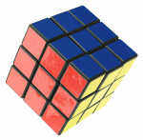
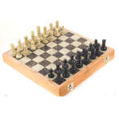
Branching factors for some problems
The eight puzzle has a (effective) branching factor of 2.13, so a search tree at depth 20 has about 3.7 million nodes: O(b^{d})
Rubik’s cube has a (effective) branching factor of 13.34. There are 901,083,404,981,813,616 different states. The average depth of a solution is about 18.
Chess has a branching factor of about 35, there are about 10¹²⁰ states (there are about 10⁷⁹ electrons in the universe).
2
1
3
4
7
6
5
8

Slide 14
Uninformed search strategies (Blind search)
Uninformed (blind) strategies use only the information available in the problem definition. These strategies order nodes without using any domain specific information
Contrary to Informed search techniques which might have additional information (e.g. a compass).
Breadth-first search
Uniform-cost search
Depth-first search
Depth-limited search
Iterative deepening search
Bidirectional search

Slide 15
Basic Search Algorithms
Uninformed Search
Breadth First Search (BFS)

Slide 16
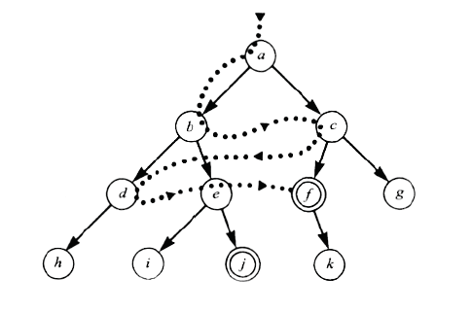
Breadth First Search (BFS)

Slide 17
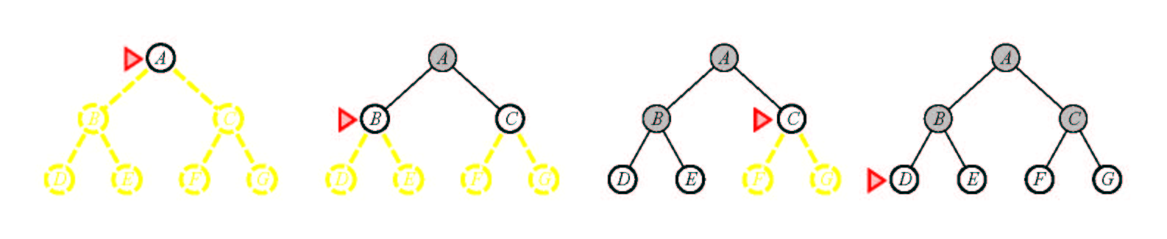
Breadth First Search (BFS)
Main idea: Expand all nodes at depth (i) before expanding nodes at depth (i + 1)
Level-order Traversal.
Implementation: Use of a First-In-First-Out queue (FIFO). Nodes visited first are expanded first. Enqueue nodes in FIFO (first-in, first-out) order.
Complete? Yes.
Optimal? Yes, if path cost is nondecreasing function of depth
Time Complexity: O(b^{d})
Space Complexity: O(b^{d}), note that every node in the fringe is kept in the queue.

Slide 18
Breadth First Search
Application1:
Given the following state space (tree search), give the sequence of visited nodes when using BFS (assume that the nodeO is the goal state):
A
B
C
D
E
F
G
H
I
J
K
L
M
N
O

Slide 19
Breadth First Search
A,
A
B
C
D
E

Slide 20
Breadth First Search
A,
B,
A
B
C
D
E
F
G

Slide 21
Breadth First Search
A,
B,C
A
B
C
D
E
F
G
H

Slide 22
Breadth First Search
A,
B,C,D
A
B
C
D
E
F
G
H
I
J

Slide 23
Breadth First Search
A,
B,C,D,E
A
B
C
D
E
F
G
H
I
J

Slide 24
Breadth First Search
A,
B,C,D,E,
F,
A
B
C
D
E
F
G
H
I
J

Slide 25
Breadth First Search
A,
B,C,D,E,
F,G
A
B
C
D
E
F
G
H
I
J
K
L

Slide 26
Breadth First Search
A,
B,C,D,E,
F,G,H
A
B
C
D
E
F
G
H
I
J
K
L

Slide 27
Breadth First Search
A,
B,C,D,E,
F,G,H,I
A
B
C
D
E
F
G
H
I
J
K
L
M

Slide 28
Breadth First Search
A,
B,C,D,E,
F,G,H,I,J,
A
B
C
D
E
F
G
H
I
J
K
L
M
N

Slide 29
Breadth First Search
A,
B,C,D,E,
F,G,H,I,J,
K,
A
B
C
D
E
F
G
H
I
J
K
L
M
N

Slide 30
Breadth First Search
A,
B,C,D,E,
F,G,H,I,J,
K,L
A
B
C
D
E
F
G
H
I
J
K
L
M
N
O

Slide 31
Breadth First Search
A,
B,C,D,E,
F,G,H,I,J,
K,L, M,
A
B
C
D
E
F
G
H
I
J
K
L
M
N
O

Slide 32
Breadth First Search
A,
B,C,D,E,
F,G,H,I,J,
K,L, M,N,
A
B
C
D
E
F
G
H
I
J
K
L
M
N
O

Slide 33
Breadth First Search
A,
B,C,D,E,
F,G,H,I,J,
K,L, M,N,
Goal state: O
A
B
C
D
E
F
G
H
I
J
K
L
M
N
O

Slide 34
Breadth First Search
The returned solution is the sequence of operators in the path:
A, B, G, L, O
A
B
C
D
E
F
G
H
I
J
K
L
M
N
O

Slide 35
Basic Search Algorithms
Uninformed Search
Uniform Cost Search (UCS)

Slide 36
Uniform Cost Search (UCS)
5
2
[5]
[2]
1
4
1
7
[6]
[3]
[9]
[9]
Goal state
4
5
[x] = g(n)
path cost of node n
[7]
[8]

Slide 37
Uniform Cost Search (UCS)
5
2
[5]
[2]

Slide 38
Uniform Cost Search (UCS)
5
2
[5]
[2]
1
7
[3]
[9]

Slide 39
Uniform Cost Search (UCS)
5
2
[5]
[2]
1
7
[3]
[9]
4
5
[7]
[8]

Slide 40
Uniform Cost Search (UCS)
5
2
[5]
[2]
1
4
1
7
[6]
[3]
[9]
[9]
4
5
[7]
[8]

Slide 41
Uniform Cost Search (UCS)
5
2
[5]
[2]
Goal state path cost g(n)=[6]
1
4
1
7
[3]
[9]
[9]
4
5
[7]
[8]

Slide 42
Uniform Cost Search (UCS)
5
2
[5]
[2]
1
4
1
7
[6]
[3]
[9]
[9]
4
5
[7]
[8]

Slide 43
Uniform Cost Search (UCS)
In case of equal step costs, Breadth First search finds the optimal solution.
For any step-cost function, Uniform Cost search expands the node n with the lowest path cost.
UCS takes into account the total cost: g(n).
UCS is guided by path costs rather than depths. Nodes are ordered according to their path cost.

Slide 44
Uniform Cost Search (UCS)
Main idea: Expand the cheapest node. Where the cost is the path cost g(n).
Implementation:
Enqueue nodes in order of cost g(n).
QUEUING-FN:- insert in order of increasing path cost.
Enqueue new node at the appropriate position in the queue so that we dequeue the cheapest node.
Complete? Yes.
Optimal? Yes, if path cost is nondecreasing function of depth
Time Complexity: O(b^{d})
Space Complexity: O(b^{d}), note that every node in the fringe keep in the queue.

Slide 45
Basic Search Algorithms
Uninformed Search
Depth First Search (DFS)

Slide 46
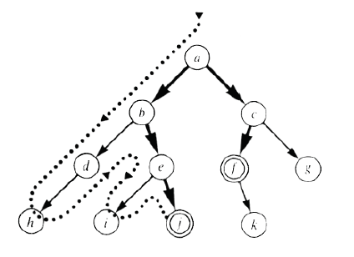
Depth First Search (DFS)

Slide 47
Depth First Search (DFS)
Application2:
Given the following state space (tree search), give the sequence of visited nodes when using DFS (assume that the nodeO is the goal state):
A
B
C
D
E
F
G
H
I
J
K
L
M
N
O

Slide 48
Depth First Search
A,
A
B
C
D
E

Slide 49
Depth First Search
A,B,
A
B
C
D
E
F
G

Slide 50
Depth First Search
A,B,F,
A
B
C
D
E
F
G

Slide 51
Depth First Search
A,B,F,
G,
A
B
C
D
E
F
G
K
L

Slide 52
Depth First Search
A,B,F,
G,K,
A
B
C
D
E
F
G
K
L

Slide 53
Depth First Search
A,B,F,
G,K,
L,
A
B
C
D
E
F
G
K
L
O

Slide 54
Depth First Search
A,B,F,
G,K,
L, O: Goal State
A
B
C
D
E
F
G
K
L
O

Slide 55
Depth First Search
The returned solution is the sequence of operators in the path: A, B, G, L, O
A
B
C
D
E
F
G
K
L
O

Slide 56
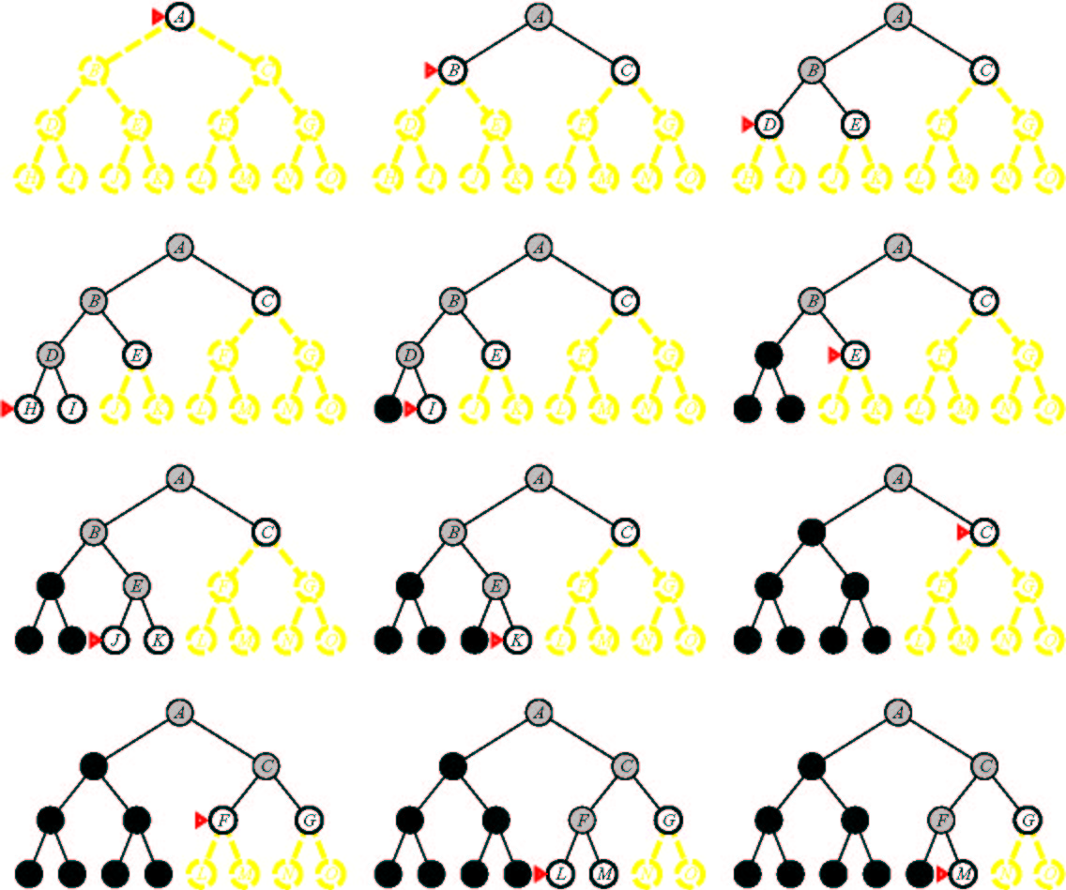
Depth First Search

Slide 57
Depth First Search (DFS)
Main idea: Expand node at the deepest level (breaking ties left to right).
Implementation: use of a Last-In-First-Out queue or stack(LIFO). Enqueue nodes in LIFO (last-in, first-out) order.
Complete? No (Yes on finite trees, with no loops).
Optimal? No
Time Complexity: O(b^{m}), where m is the maximum depth.
Space Complexity: O(bm), where m is the maximum depth.

Slide 58
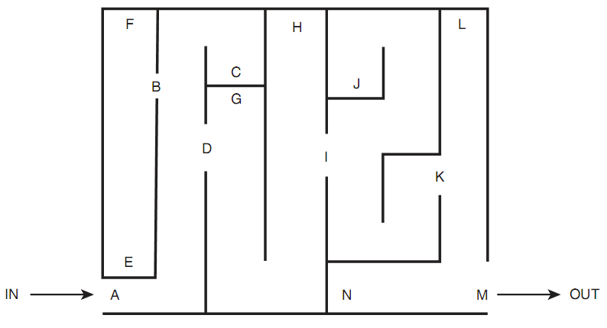
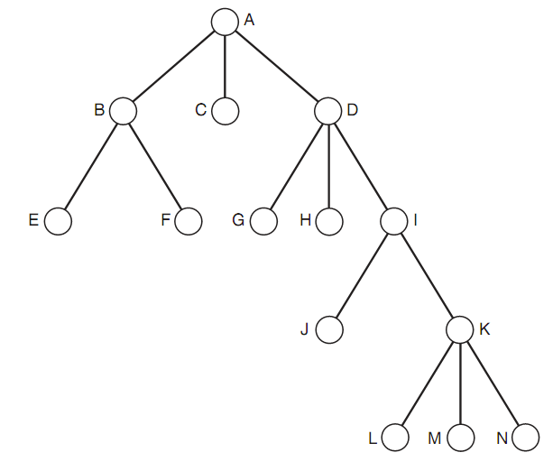
Mapping DFS to Real
World Problems
Traversing a Maze
Always left (right) hand on the wall

Slide 59
Mapping DFS to Real
World Problems
Searching for a Gift
  Number of shops, each have several floors
What you naturally do?

Slide 60
Basic Search Algorithms
Uninformed Search
Depth-Limited Search (DLS)

Slide 61

Depth-Limited Search (DLS)
Depth Bound = 3

Slide 62
Depth-Limited Search (DLS)
Application3:
Given the following state space (tree search), give the sequence of visited nodes when using DLS (Limit = 2):
Limit = 0
A
Limit = 1
B
C
D
E
Limit = 2
F
G
H
I
J
K
L
M
N
O

Slide 63
Depth-Limited Search (DLS)
A,
A
B
C
D
E
Limit = 2

Slide 64
Depth-Limited Search (DLS)
A,B,
A
B
C
D
E
Limit = 2
F
G

Slide 65
Depth-Limited Search (DLS)
A,B,F,
A
B
C
D
E
Limit = 2
F
G

Slide 66
Depth-Limited Search (DLS)
A,B,F,
G,
A
B
C
D
E
Limit = 2
F
G

Slide 67
Depth-Limited Search (DLS)
A,B,F,
G,
C,
A
B
C
D
E
Limit = 2
F
G
H

Slide 68
Depth-Limited Search (DLS)
A,B,F,
G,
C,H,
A
B
C
D
E
Limit = 2
F
G
H

Slide 69
Depth-Limited Search (DLS)
A,B,F,
G,
C,H,
D,
A
B
C
D
E
Limit = 2
F
G
H
I
J

Slide 70
Depth-Limited Search (DLS)
A,B,F,
G,
C,H,
D,I
A
B
C
D
E
Limit = 2
F
G
H
I
J

Slide 71
Depth-Limited Search (DLS)
A,B,F,
G,
C,H,
D,I
J,
A
B
C
D
E
Limit = 2
F
G
H
I
J

Slide 72
Depth-Limited Search (DLS)
A,B,F,
G,
C,H,
D,I
J,
E
A
B
C
D
E
Limit = 2
F
G
H
I
J

Slide 73
Depth-Limited Search (DLS)
A,B,F,
G,
C,H,
D,I
J,
E, Failure
A
B
C
D
E
Limit = 2
F
G
H
I
J

Slide 74
Depth-Limited Search (DLS)
DLS algorithm returns Failure (no solution)
The reason is that the goal is beyond the limit (Limit =2): the goal depth is (d=4)
A
B
C
D
E
Limit = 2
F
G
H
I
J
K
L
M
N
O

Slide 75
Depth-Limited Search (DLS)
It is simply DFS with a depth bound.
  Searching is not permitted beyond the depth bound.
Works well if we know what the depth of the solution is.
Termination is guaranteed.
If the solution is beneath the depth bound, the search cannot find the goal (hence this search algorithm is incomplete).
Otherwise use Iterative deepening search (IDS).

Slide 76
Depth-Limited Search (DLS)
Main idea: Expand node at the deepest level, but limit depth to L.
Implementation:
Enqueue nodes in LIFO (last-in, first-out) order. But limit depth to L
Complete? Yes if there is a goal state at a depth less than L
Optimal? No
Time Complexity: O(b^{L}), where L is the cutoff.
Space Complexity: O(bL), where L is the cutoff.

Slide 77
Basic Search Algorithms
Uninformed Search
Iterative Deepening Search (IDS)

Slide 78
Iterative Deepening Search (IDS)
function ITERATIVE-DEEPENING-SEARCH():
for depth = 0 to infinity do
if DEPTH-LIMITED-SEARCH(depth) succeeds
then return its result
end
return failure

Slide 79

Iterative deepening search L=0

Slide 80

Iterative deepening search L=1

Slide 81

Iterative deepening search L=2

Slide 82

Iterative Deepening Search L=3

Slide 83
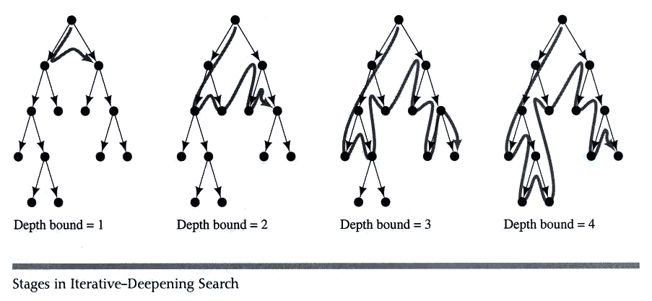
Iterative deepening search

Slide 84
Iterative Deepening Search (IDS)
Key idea
  Iterative deepening search (IDS) applies DLS repeatedly with increasing depth. It terminates when a solution is found or no solutions exists.
  IDS combines the benefits of BFS and DFS
  Like DFS the memory requirements are very modest (O(bd)).
  Like BFS, it is complete when the branching factor is finite.

Slide 85
Iterative Deepening Search (IDS)
Key idea
  Seems wastefull becuase states are generated multiple times
  But not like that, it is as efficient as BFS or DFS; because majority of the nodes are in the deepest level
  For BFS total number of generated nodes are
  N(BFS) = 1 + b + b² + b³ + … … + b^{d}
  = (1 – b^{d+1}) / (1 – b )
  For Iterative Deepening Search
    Nodes at bottom level (depth d) are generated once
    Next to bottom generated twice
    The total number of generated nodes is
  N(IDS)= db + (d-1)b² + (d-2)b³ + … … + (1)b^{d} + (d+1)

Slide 86
Iterative Deepening Search (IDS)
Coparison between DFS and IDS
  Let a tree of depth 4 and branching factor of 10
  For BFS total number of generated nodes are
  N(BFS) = 1 + b + b² + b³ + … … + b^{d}
  = (1 – b^{d+1}) / (1 – b )
  = (1 – 10⁴⁺¹) / (1 – 10)
  = 11,111 nodes
  For Iterative Deepening Search (IDS)
    The total number of generated nodes is
  N(IDS)= (d+1)b⁰ + db¹ + (d-1)b² + (d-2)b³ + … … + (1)b^{d}
  = (4 + 1) + 4 * 10 + 3 + 100 + 2 * 1000 + 10000
  = 12,345 nodes
  In general, iterative deepening is the preferred uninformed search method when there is a large search space and the depth of the solution is not known.

Slide 87
Basic Search Algorithms
Uninformed Search
Bi-Directional Search (BDS)

Slide 88
Bi-directional Search (BDS)
Main idea: Start searching from both the initial state and the goal state, meet in the middle.
Complete? Yes
Optimal? Yes
Time Complexity: O(b^{d/2}), where d is the depth of the solution.
Space Complexity: O(b^{d/2}), where d is the depth of the solution.

Slide 89
Basic Search Algorithms
Comparison of search algorithms

Slide 90
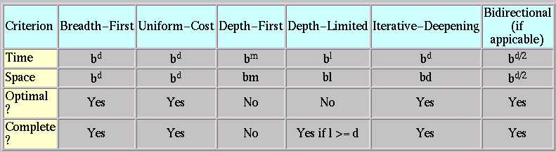
Comparison of search algorithms
b: Branching factor
d: Depth of solution
m: Maximum depth
l : Depth Limit

Slide 91
Summary
Search: process of constructing sequences of actions that achieve a goal given a problem.
The studied methods assume that the environment is observable, deterministic, static and completely known.
Goal formulation is the first step in solving problems by searching. It facilitates problem formulation.
Formulating a problem requires specifying four components: Initial states, operators, goal test and path cost function. Environment is represented as a state space.
A solution is a path from the initial state to a goal state.
Search algorithms are judged on the basis of completeness, optimality, time complexity and space complexity.
Several search strategies: BFS, DFS, DLS, IDS,…
All uninformed searches have an exponential time complexity – hopeless as a viable problem solving mechanism (unless you have a quantum computer!)

Slide 92
References
Chapter 3 of “Artificial Intelligence: A modern approach” by Stuart Russell, Peter Norvig.
Chapter 4 of “Artificial Intelligence Illuminated” by Ben Coppin

